Slide 1
Team 3 Service Fabric Hackers

Slide 2

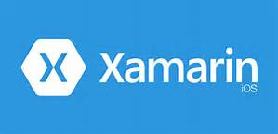




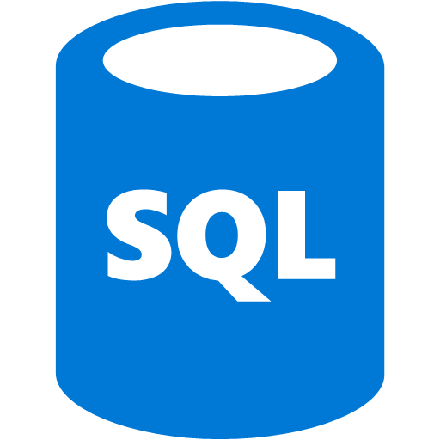
V2 Aspirations
Machine Learning to predict portfolio basis…
C# Application for User secure LOGON, entering portfolio items, viewing current portfolio
Web app to lookup portfolio values from 401K.com, wellsfargo.com, Zillow…
Service Fabric for stateless data – hydrated from SQL DB
SQL DB for TDE, geo-replication: USERS, Portfolio types, Portfolio assets, Portfolio History Values

Slide 3
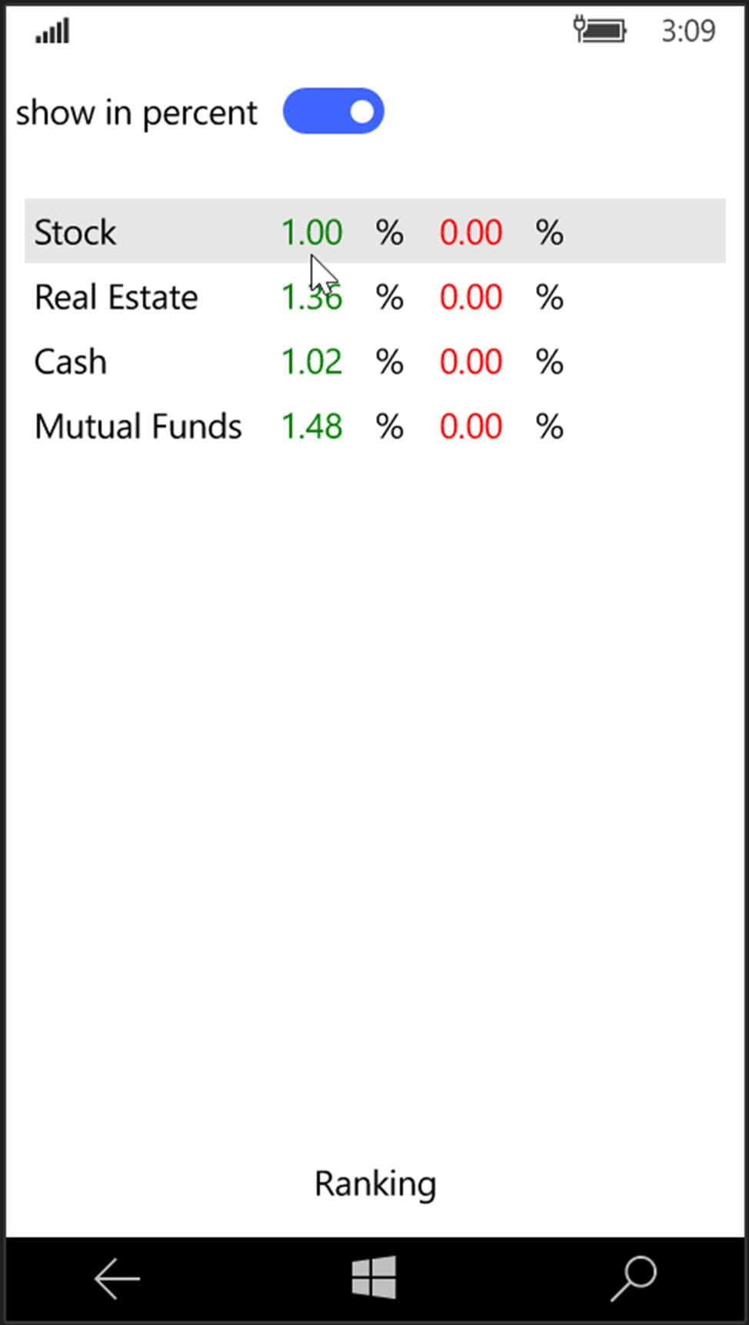
Xamarin App

Slide 4
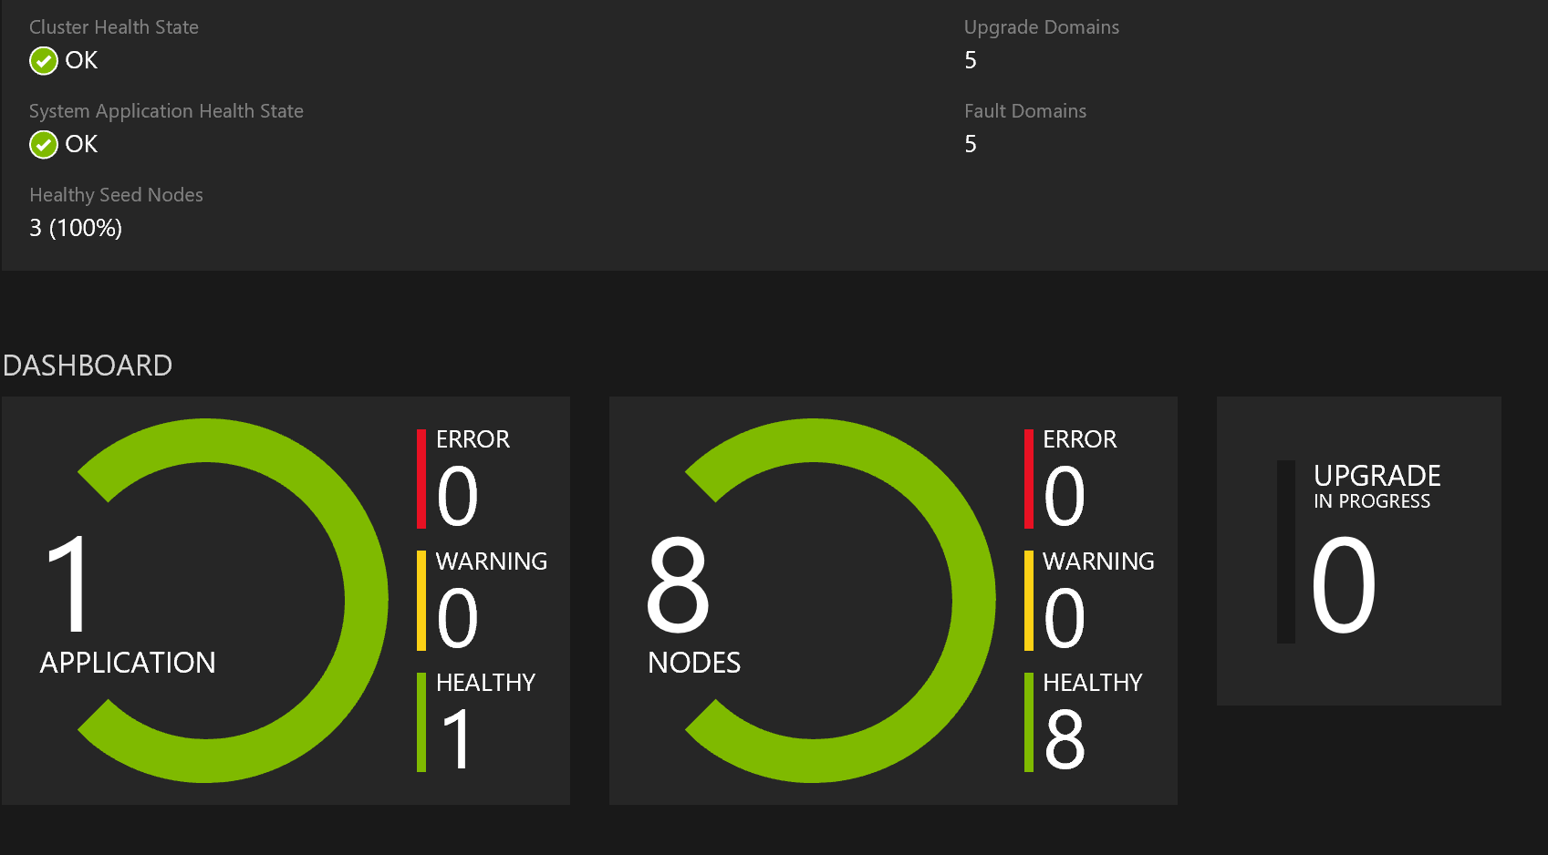
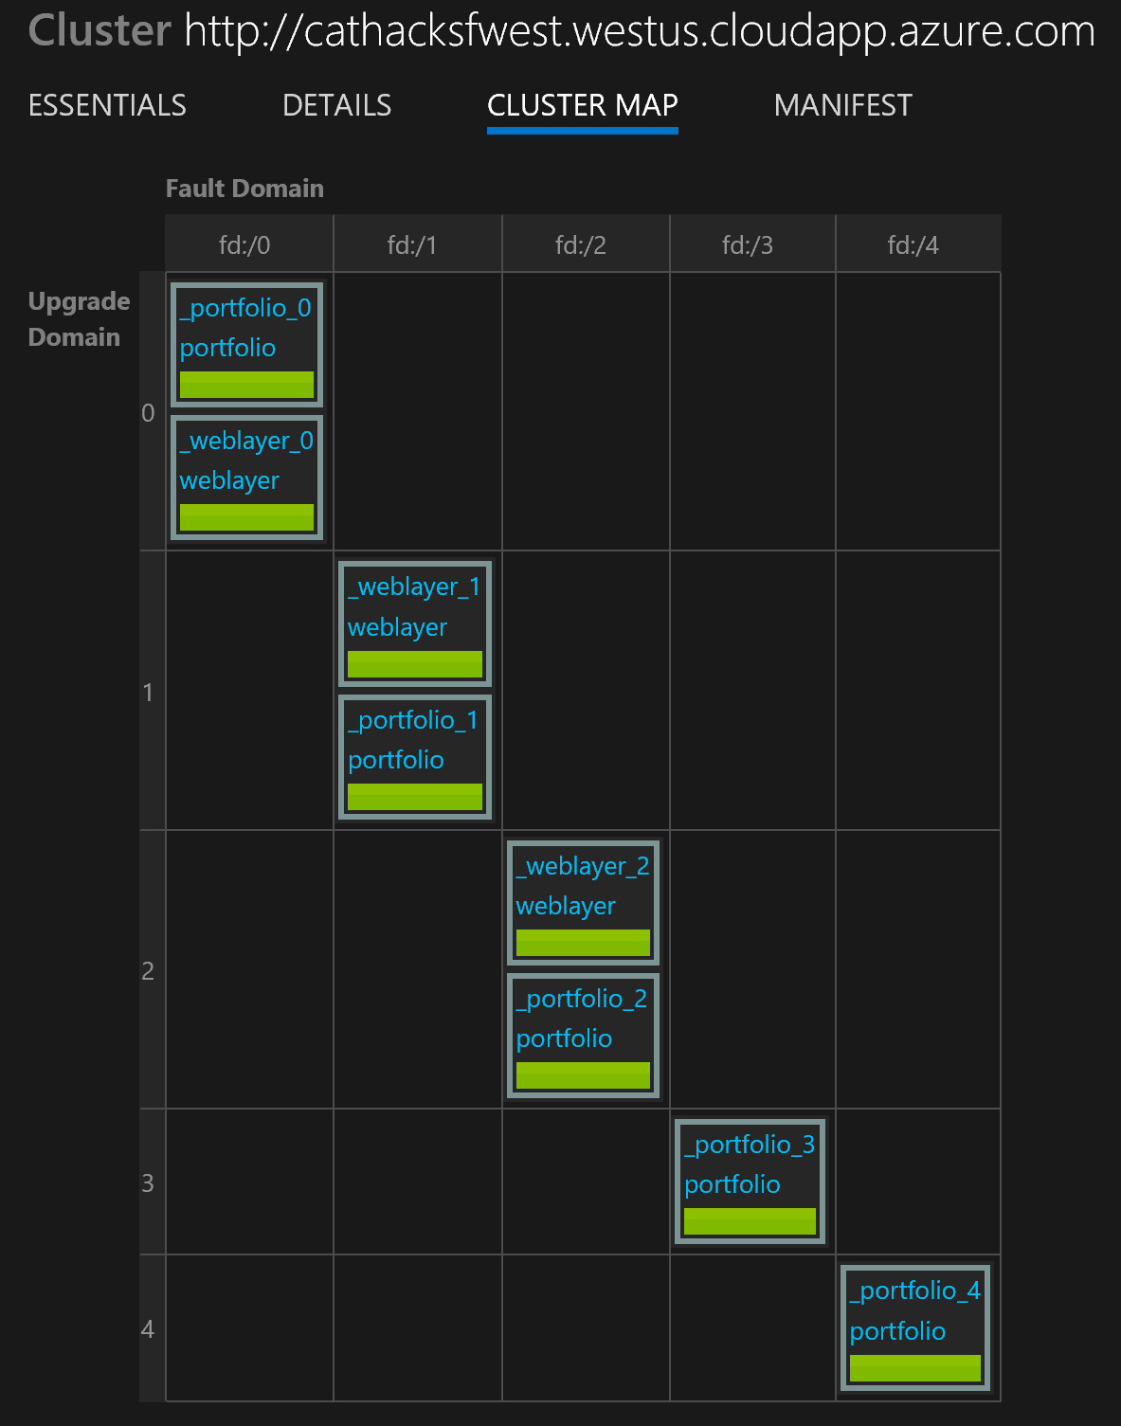
Service Fabric Cluster

Slide 5
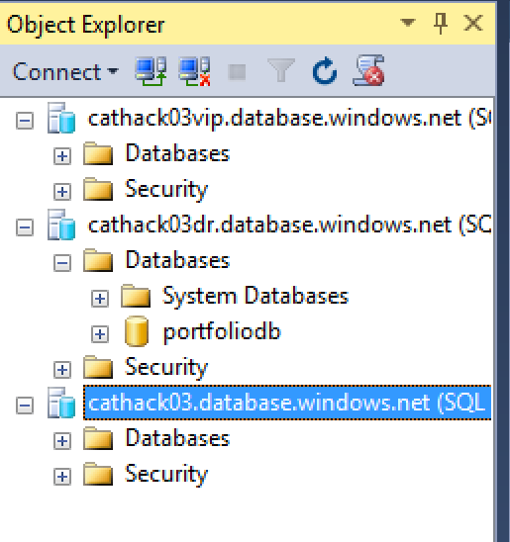
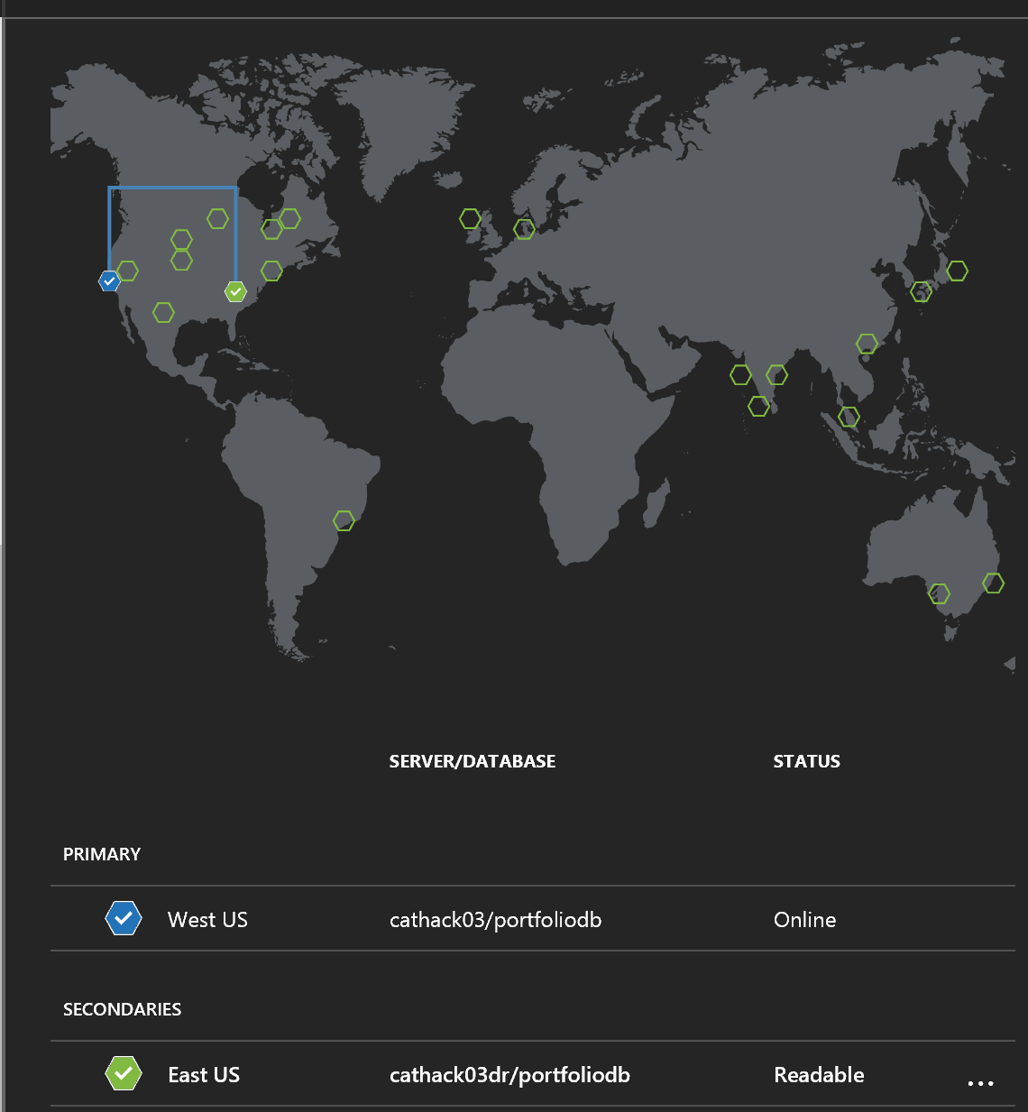
Persistence Layer: SQL DB, Read Geo DR, VIP

Slide 6
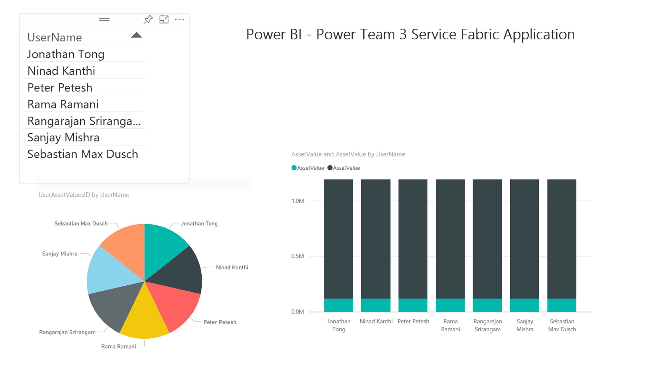
Power BI Visualization

Slide 7
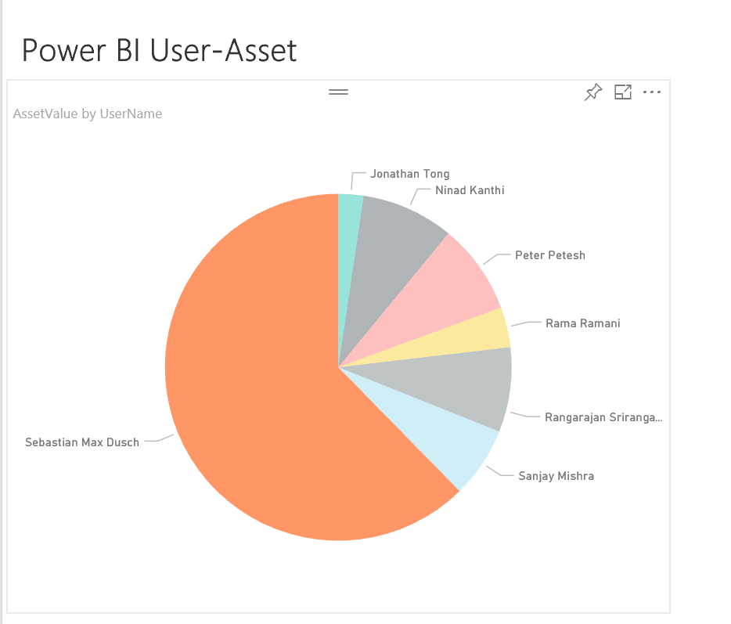
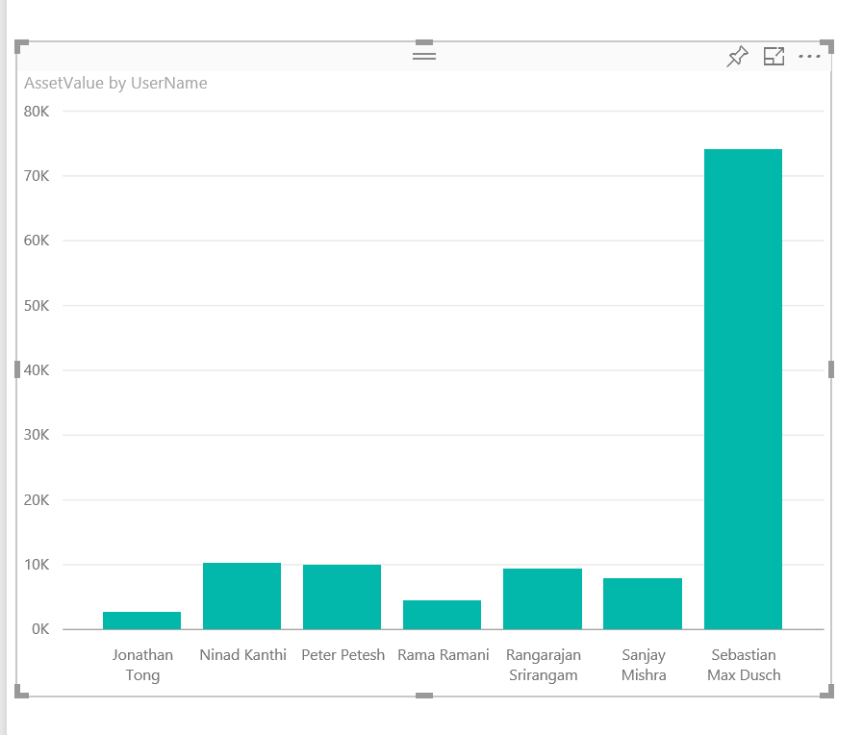
Power BI Visualization

Slide 8
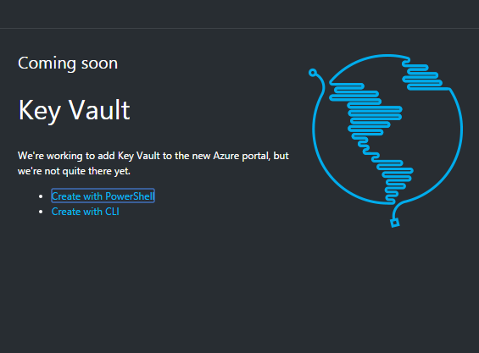
Learnings
Github 2FA can multiply MSIT auth challenges exponentially!
SQL DB
User with admin rights unable to login with additional firewall rules
Latency with schema changes visible to additional admins
Identity management challenges with integration with:
Data tier & seamless across application layers/services
Service Hub
Notion of ‘Primary’ in node type is confusing – primary and secondary replicas conflicting with node type referring to ‘stateless’, ‘stateful’
Notion of ‘bronze’, ‘platinum’ etc. is hard to understand
Custom Section needs docs link or some explanation
SF needs a key vault link for a secure app which is asked at the end. Why not ask at the beginning?
Quota errors at the end! Damn
Created a cluster with 2 node types and as part of checkpoint tried to publish only the solution with stateless got an error “package action not set”. But when added a “Stateful service” to match the cluster node types it worked
Keyvault
No support in Portal (promised coming soon)
Power BI
PBI connectivity to SQL DB easy, PBI desktop hard
Can perform data shaping of model in PBI desktop hard in browser experience

